Slide 1
Hospital Pharmacy Workflow
A New Prospective for Better Care
Dr. Mona Baalbaki;
Rph, Head of Pharmacy- RHUH

Slide 2
RHUH is a University Hospital Serving
Various Specialties
Internal Medicine
CCU
ICU
Delivery
Pediatrics
Oncology
Surgery
OBS & GYN

Slide 3
Pharmacy Mission
Our mission is to provide
Cost Effective
High quality
Quick
Drug Therapy

Slide 4
Pharmacy Vision
Meet international practice criteria
Continuously improve its performance
Contribute to optimal patient care
Integrate itself in patient care
Foster an Educational Environment

Slide 5
Our Philosophy
  “We care for each other ,realizing that all positions and individuals are equally important to the achievement of our goals”

Slide 6
The Pharmacy Department at RHUH is a full service automated computerized inpatient facility providing a wide range of services both to the patient and hospital medical staff.
Computerized

Slide 7
Old fashion way Vs. Computerized way
Capoten Gopten
Centrum Sintrom
Corvasal Coversyl
Less Errors
No abbreviations
No bad hand writing
No verbal orders

Slide 8

Old fashion way Vs. Computerized way (cont’d)
The pharmacist has full access to the patient profile from his office rendering the work much more easier and faster

Slide 9
Old fashion way Vs. Computerized way (cont’d)
Provides services through an error free system.
Controlled Pharmaceutical expenses.
Continuous update of the electronic system.

Slide 10
Old fashion way Vs. Computerized way (cont’d)
The full access to the patient profile allows the pharmacist to detect errors in prescribing and hence intervening to correct medical orders

Slide 11
Responsibilities of RHUH pharmacy staff
  Hospital Pharmacists are moving from prescription providers to pharmaceutical care providers.

Slide 12
Responsibilities of RHUH pharmacy staff
  Job descriptions for all pharmacy personnel should be available to define the professional and technical role of each → reviewed every 2 years in accordance to policy and procedure.

Slide 13
Responsibilities of RHUH pharmacy staff
  Review medication orders at the time of prescribing.
  Identify actual potential medical related problem.
  Prepare pharmaceutical care plan.
  Optimize compliance on drugs.
  Monitor and educate patient.

Slide 14
Responsibilities of RHUH pharmacy staff (cont’d)
Reviewing the patient medication profile on daily basis for:
    Possible modifications of ongoing treatment.
    Discontinuation of medications.
    Addition of new medications.
    Controlling appropriate route of administration.

Slide 15
Responsibilities of RHUH pharmacy staff (cont’d)
Medication Profile
Eliminating Duplication of therapeutically similar drugs.
Minimizing potential allergic or ADR’s.
Monitoring possible drug disease incompatibilities.
Controlling drug-drug interactions.
Checking correct dosage and dosage interval.
Notes:
Drug disease interactions: Tequin (Gatifloxacin) in diabetes leading to hyperglycemia.

Slide 16
Responsibilities of RHUH pharmacy staff (cont’d)
Solving problems related to intravenous administration including:
  Potential Incompatibility.
  Drug stability.
  Volume of intravenous fluid.
  Rate of Infusion.

Slide 17

Responsibilities of RHUH pharmacy staff (cont’d)
Answering drug information questions
    Guidelines and presentations to keep the hospital staff informed about newly approved drugs and any other relevant information
    Drug information questions are recorded on drug information forms.

Slide 18
Responsibilities of RHUH pharmacy staff (cont’d)
Pharmacists are also responsible for preparing drug utilization reviews (DUR) for medications such as:
      Albumin.
      LMWH.
      Intravenous Immunoglobulins (IV IG).

Slide 19
Responsibilities of RHUH pharmacy staff (cont’d)
What Are the Benefits of Reviewing the Patient Profile?

Slide 20
Responsibilities of RHUH pharmacy staff (cont’d)
Reviewing patient Profile
    Reduces medication errors.
    Delivers best patient care at minimal medical cost.
    Improve patient outcomes.
Notes:
تأمين سير الخدمة الصيدلية عبر نطام خالي من الخطأ على مدار 24 ساعة لضمان سلامة المريض وإزالة الأخطاء الطبية.

Slide 21
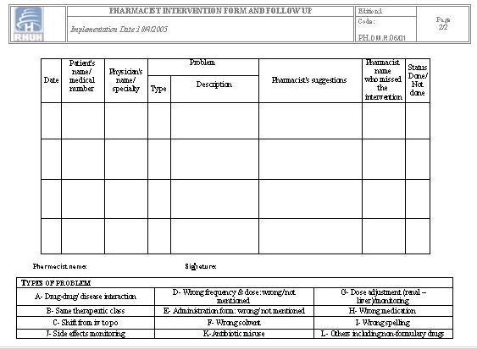
Responsibilities of RHUH pharmacy staff (cont’d)
Pharmacists Interventions
All pharmacists interventions are documented
on drug intervention form.

Slide 22
Responsibilities of RHUH pharmacy staff (cont’d)
In short, hospital pharmacists are described as :
Care givers.
Communicators.
Leaders.
Managers.
Life-long leaders.
Teachers.

Slide 23
Pharmacy Activities

Slide 24
Committees
    Occupational Health and Safety Committee.
    Research Committee.
    Disaster Committee .
    Guidance for Antibiotic Committee.
    Infection Control Committee.
    Nutrition Committee.
    Pharmacy and Therapeutics Committee.

Slide 25
Meetings
Pharmacy department conducts on a monthly basis (or when necessary) a meeting in order:
      Discuss issues related to medication ordering, dispensing, and delivering.
      Set new Guidelines / Regulations / Goals...
      Plan activities and assignments
      Identify areas needing improvement
      Take new decisions

Slide 26
Continuous Education
As directed by accreditation, it is a must to prepare a continuous education plan either for pharmacy staff or even other hospital staff. This is achieved through:
      Presentations.
      Conferences.
      Either to present new information or emphasize their own knowledge.

Slide 27
Pharmacy Related Reports
Adverse Event Reports: written by the nurses or doctors in charge and sent to the pharmacy for further review.
Medication Error Reports:
    Incident reports of all pharmacy related mistakes are written by hospital staff and sent to the pharmacy to provide a future prevention plan.
    Miss error Tracking form.
Clinical Intervention Reports: done on daily basis and discussed among all pharmacists in monthly round tables.

Slide 28

Relation with other Departments
Communication with Various Departments
Faster Collaboration and Decision making
Sharing Documents and Information

Slide 29
Drug Management
Drug management is very important because it ensures that the RIGHT DRUG of GOOD QUALITY is available when needed for a patient.
Drug Selection
Drug Receiving
Drug Storage
Drug Procurement
Drug Dispensing

Slide 30
Drug Selection
The pharmacy department at RHUH adopts the Hospital Drug Formulary System.
The pharmacy has the right to dispense formulary drugs regardless of the physician order (generic or brand).
List of all medications approved by the
P &T Committee

Slide 31
Drug Selection
There is a criteria for selecting drug products’ manufacturers and suppliers to ensure high quality of drug products.
Technical Evaluation
Notes:
سنتكلم عن هذا الموضوع بالتفصيل في محاضرة السيد نيكولا رباط عن المناقصات و اختيار الدواء المناسب

Slide 32
Drug Procurement
Selected medications are purchased in the right quantities to ensure that patients are more likely to receive necessary drugs on time.
In case of any shortage, the pharmacy informs the entire staff via intranet and tries to provide an appropriate alternative

Slide 33
Drug Storage
Medications are stored under proper conditions of:
Temperature
- Refrigerators’ temperature is monitored daily.
- Refrigerate stamp.
Light
- Special warning is given to the hospital units:
“Do not remove drugs from their original containers”.

Slide 34
Drug Storage
Cytotoxic drugs are stored separately with a special warning label.
Controlled drugs are stored under lock with access limited to pharmacists in charge..
Expired drugs are identified with an orange label and segregated for disposal according to the safety policy of the hospital.

Slide 35
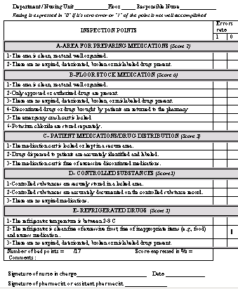
Drug Storage
All stocks of medications available in the pharmacy as well as on hospital floors are inspected monthly to ensure the absence of outdated unusable or mislabeled drugs.

Slide 36
Drug Storage
Floor Stock Inspection includes the following:
Area for preparing medications.
Floor stock medications.
Patient Medications: Quantity and Expiry Date.
Controlled Substances.
Refrigerated Drugs.

Slide 37
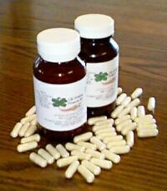
Drug Dispensing
Dispensing of medications is done using the unit dose drug distribution system.
Dispensed medications are supplied in
quantities that meet 24 hrs needs of patients.
Notes:
تعبئة الدواء كل جرعة على حدى من أجل تحضير العلاجات الفردية للحد من الأدوية المنتهية الصلاحية

Slide 38
Other Pharmacy Services

Slide 39
Chemotherapy Unit
Cancer patients are susceptible to infection hence aseptic technique in preparation is MANDATORY.
ONLY properly oriented &trained employees are allowed to handle these agents.
Clear Label with patient name drug dosage stability data and duration of infusion.
Caution – Chemotherapy Dispose of Properly

Slide 40
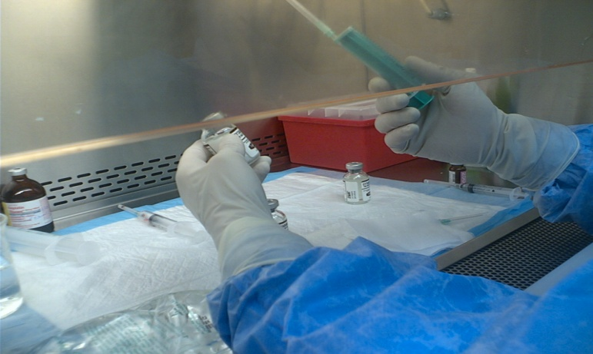
Chemotherapy Unit
Chemotherapy preparation unit is located in the main pharmacy and divided into the following sects:
    Administrative Area.
    Personnel Protection Area.
    Technical Area.

Slide 41

Future Plan…
TPN unit:
Total Parenteral Nutrition is a very important service provided by the pharmacy for all hospital wards.
Aseptic techniques should be maintained.
Calculations for adults and pediatrics
should be made on individual basis.

Slide 42
Future Plan…
IV Admixture Unit.
Patient Counseling will be implemented in order to improve:
    Patient compliance.
    Cost effectiveness.
    Quality of life.

